Slide 1
ASP.NET MVC
Lishen Ramsudh
11 January 2015

Slide 2
Contents
Getting started
MVC Intro
Creating a new ASP.NET MVC web project
Adding a model
Adding a controller
Adding a view
Routing
UI and Layouts
Razor Syntax
Razor Views
Working with Partial Views
Working with data
Performance
Bundling and Minification
Further Reading Material

Slide 3
Disclaimer
Microsoft and Visual Studio sometimes try to do too much for you in its attempt to push convention over configuration. Be careful with visual studio scaffolding everything for you. Try to understand why things are there. You will see in the videos, under references, that even Microsoft techies get it wrong.

Slide 4
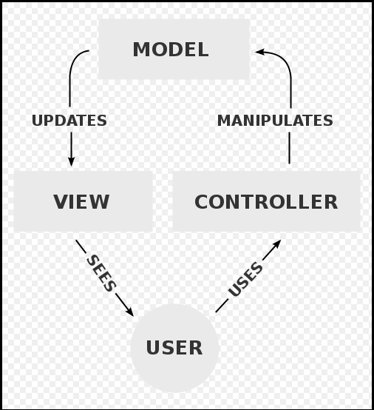
MVC Intro
Trygve Reenskaug introduced MVC into Smalltalk-76 while visiting Xerox Parc in the 1970s. In the 1980s, Jim Althoff and others implemented a version of MVC for the Smalltalk-80 class library. It was only later, in a 1988 article in The Journal of Object Technology, that MVC was expressed as a general concept^{[1]}
Notes:
Model–view–controller (MVC) is a software architectural pattern for implementing user interfaces. It divides a given software application into three interconnected parts, so as to separate internal representations of information from the ways that information is presented to or accepted from the user.
A controller can send commands to the model to update the model's state (e.g., editing a document). It can also send commands to its associated view to change the view's presentation of the model (e.g., by scrolling through a document).
A model notifies its associated views and controllers when there has been a change in its state. This notification allows the views to produce updated output, and the controllers to change the available set of commands. In some cases an MVC implementation might instead be "passive," so that other components must poll the model for updates rather than being notified. SignalR, which is an ASP.NET library can make it seem as though changes to the model can “Push” this to web clients but that is in the context of real-time web systems. In the context of ALL MVC web sites, however, the paradigm that a model must be polled holds true.
A view requests information from the model that it uses to generate an output representation to the user.

Slide 5
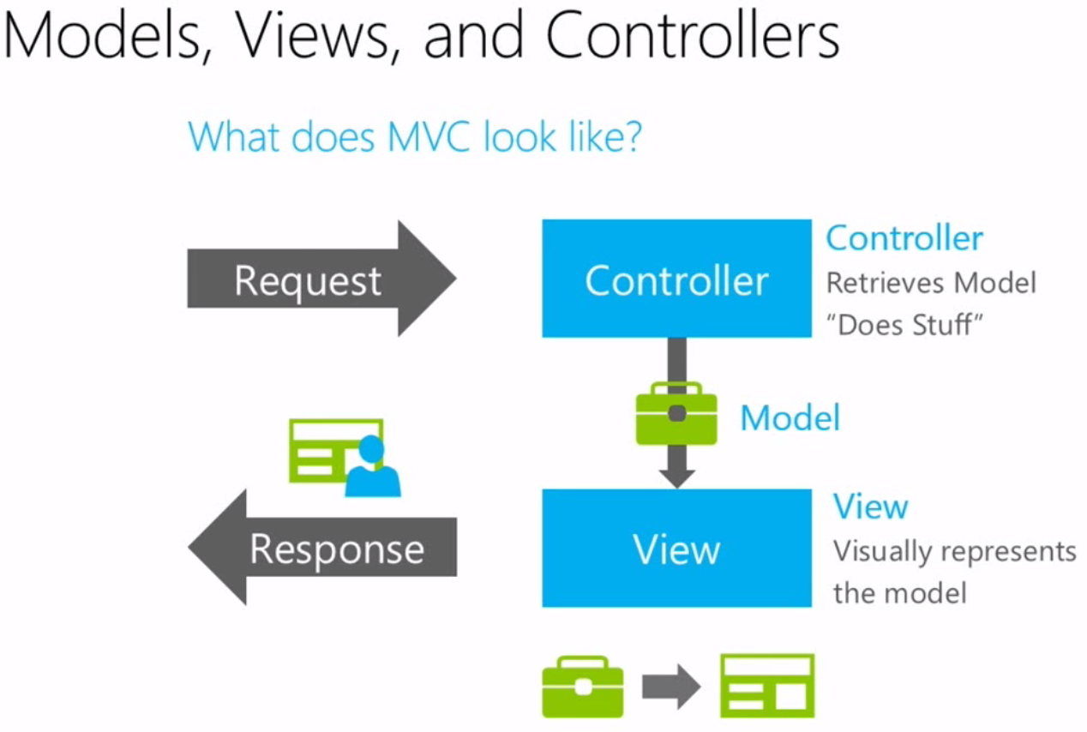
MVC Intro
[2]
Notes:
Separation of concerns. The controller manipulates data and returns it to the view. This is NOT your whole application. This is a representation of MVC. The application is built on top of this. The controller will call out to services etc…

Slide 6
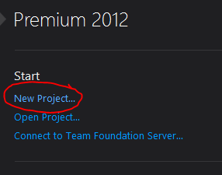
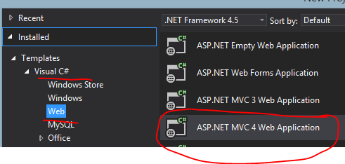
Creating a new ASP.NET MVC Web Project
VS 2013 is a bit different (see reference videos for that)
VS 2012 SampleMVCApplication creation

Slide 7
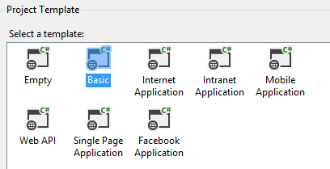
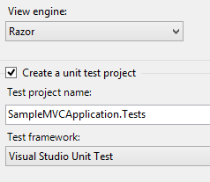
Creating a new ASP.NET MVC Web Project

Slide 8
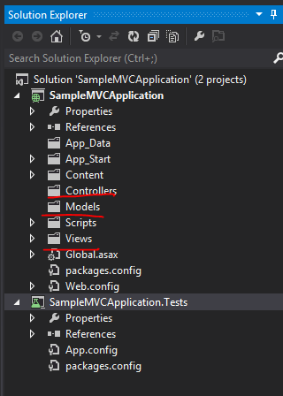
Creating a new ASP.NET MVC Web Project

Slide 9
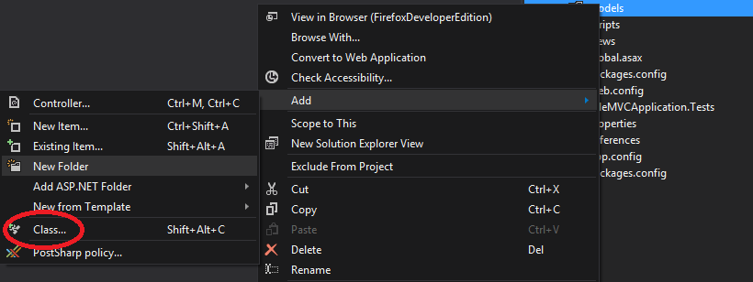
Adding a model
Notes:
What is a model?
A model is a class. That’s it! Moreover, it is a model with properties.

Slide 10
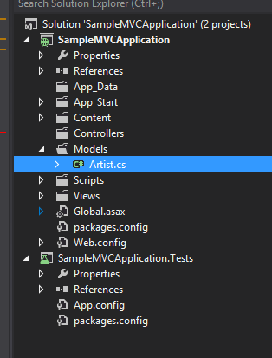
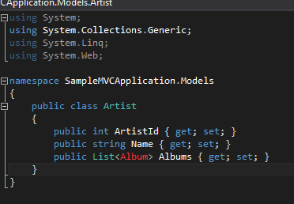
Adding a model

Slide 11
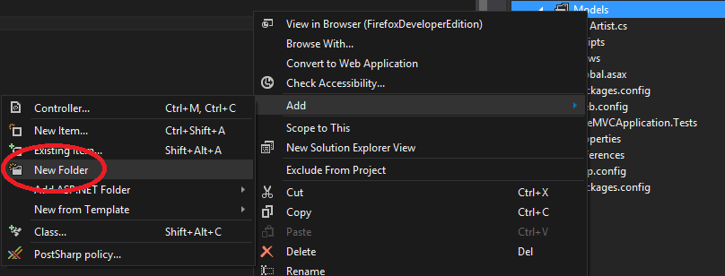
Organizing your models
Notes:
Organize your models using namespaces. Since models are mainly used for input and display purposes, you can organize your models in the same way. You can use Entity Framework models as your models directly (since a model is a class by nature and nothing else). The main reason for this is that an Entity Framework generates “Domain Objects” that contain a lot of metadata that you might not want to be sent via the wire to your user. Try to use only what is necessary.

Slide 12
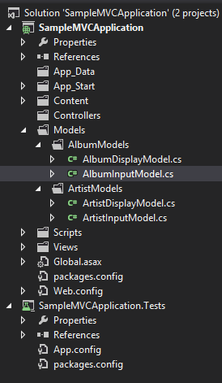
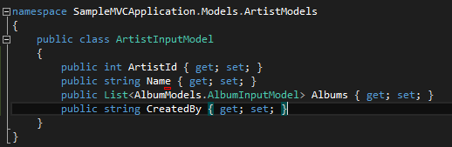
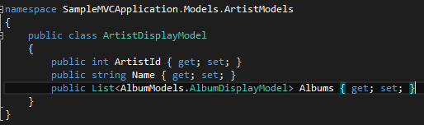
Organizing your models
Notes:
Organize your models using namespaces. Since models are mainly used for input and display purposes, you can organize your models in the same way. You can use Entity Framework models as your models directly (since a model is a class by nature and nothing else). The main reason for this is that an Entity Framework generates “Domain Objects” that contain a lot of metadata that you might not want to be sent via the wire to your user. Try to use only what is necessary.

Slide 13
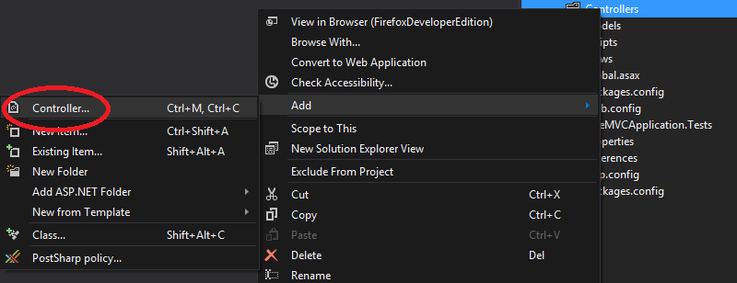
Adding a controller

Slide 14
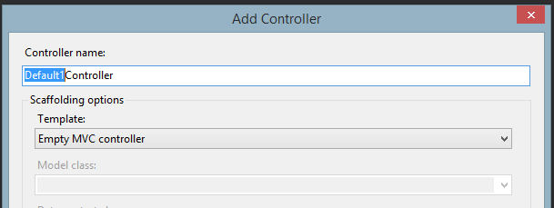
Adding a controller
Notes:
Here is where convention over configuration starts to play its part. Basically it is like creating a new class that inherits from a Controller class.

Slide 15
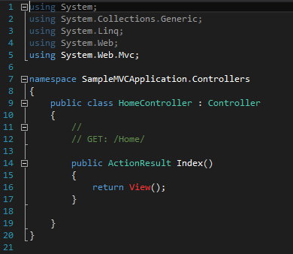
Adding a controller
Notes:
Here is where convention over configuration starts to play its part. If you want to go to the URL: localhost/Home then it will default to the Index view of the Home Controller. All controllers are suffixed with Controller by convention.

Slide 16
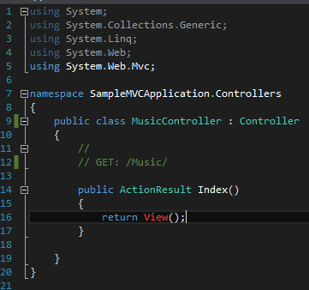
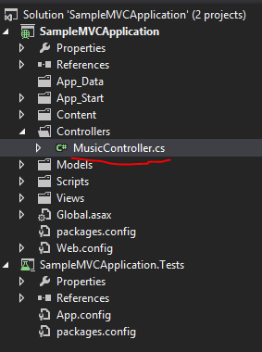
Adding a controller
If I were to rename the Home controller to the Music controller then the controller would look as follows
Notes:
Here is where convention over configuration starts to play its part. If you want to go to the URL: localhost/Music then it will default to the Index view of the Music Controller. All controllers are suffixed with Controller by convention.

Slide 17

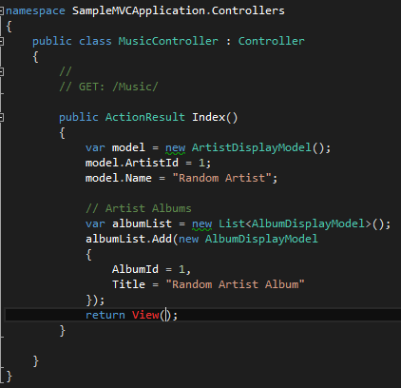
Adding a controller
Lets manipulate a display model now
Allows me to use the classes within that namespace (similar to the imports in Java)

Slide 18
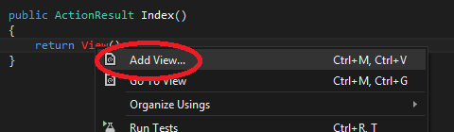
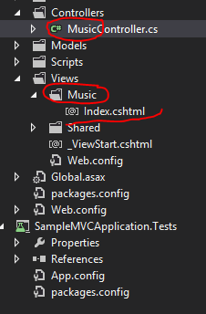
Adding a view

Slide 19
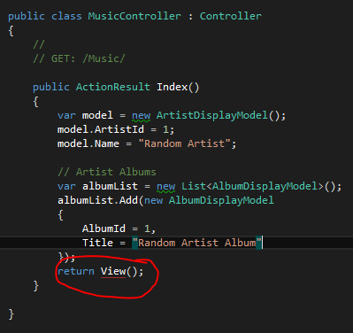
Adding a view
Notes:
Now you can CTRL+Click on View() to go to the Index view. May be a resharper function. Either way, install resharper ☺

Slide 20
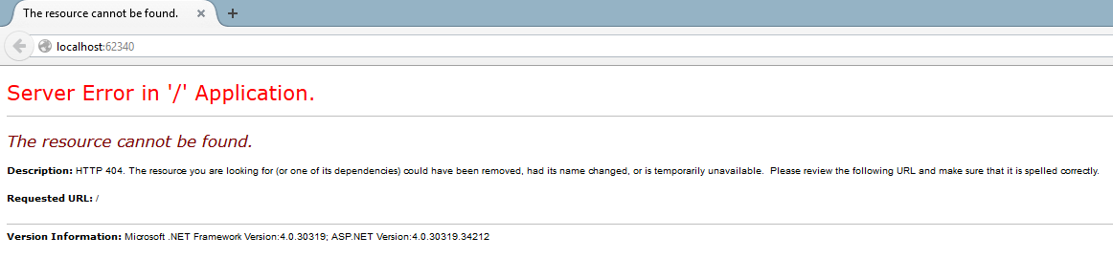
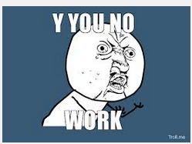
Adding a view
Try to run?
Notes:
Now you can CTRL+Click on View() to go to the Index view

Slide 21
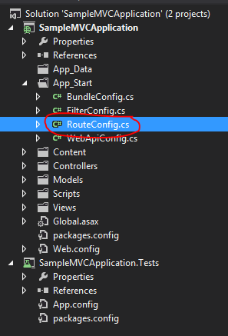
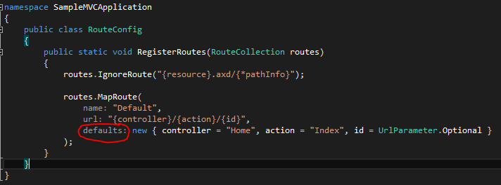
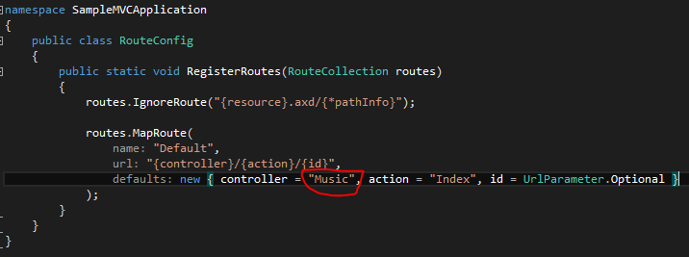
Routing
Notes:
Remember: We don’t have a Home controller with an Index controller action (method). So the default fails by that logic. So we need to change it to work the way we want it to work

Slide 22
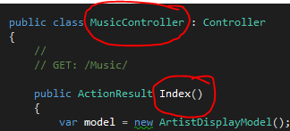
Routing
Naming conventions
<Name>Controller
Controller <Action> (method within the controller)
Results in URL <Name>/Action

Slide 23
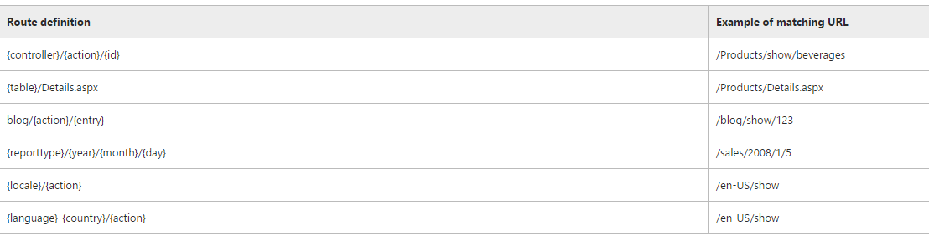
Routing
^{[3]}“ASP.NET routing enables you to use URLs that do not have to map to specific files in a Web site. Because the URL does not have to map to a file, you can use URLs in a Web application that are descriptive of the user's action and therefore more easily understood by users”
Notes:
The table shows valid route patterns and examples of URL requests that match the patterns.

Slide 24
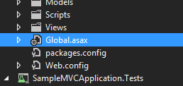
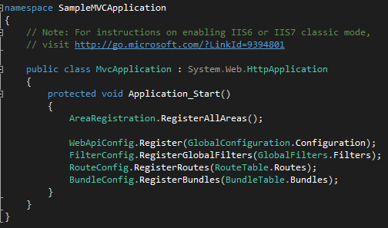
Routing
Your Global.asax is the start of your web application. When your web site starts, it goes here first
Routes are registered here at start-up via the RouteConfig.RegisterRoutes method shown previously

Slide 25
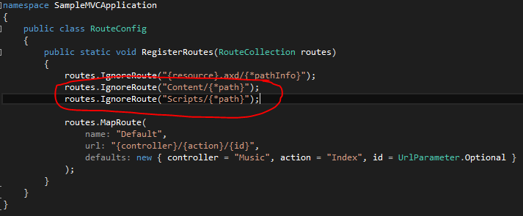
Routing
You can add more routes or ignore some (as is the case below)
See here for more information on routing - https://msdn.microsoft.com/en-us/library/cc668201.aspx

Slide 26
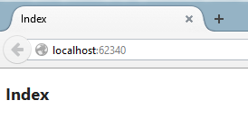
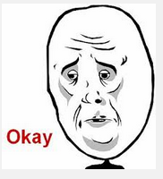
Routing
Now it works!
Its quite sad that we are happy about a blank page that says Index
Notes:
So now we go ahead and start with UI and Layout…next

Slide 27
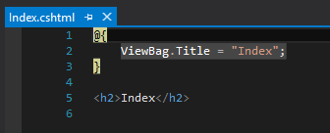
UI, Layouts and Themes
Your current view (generated when adding a new view looks like this
Enter Razor Syntax…

Slide 28
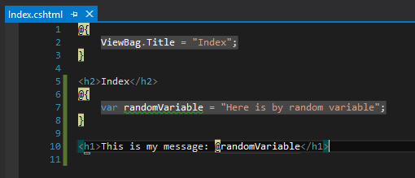
UI and Layouts
Razor allows you to write C# code within your HTML view. So lets write some random code
Notes:
Note when you have a view open (a cshtml file) then VS tries to run the site and access that file directly, which violates the MVC pattern and you get an exception. So open a controller or some other class before you hit “Run”
@functions Razor – block where you can put functions in

Slide 29
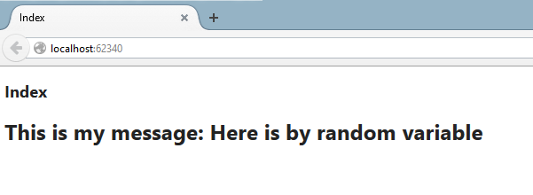
UI, Layouts and Themes

Slide 30
UI and Layouts
You can even write functions in your views
Following separation of concerns, ONLY VIEW LOGIC – logic that determines how your view will display – should be placed there. Any data logic should be placed on the controller or, even better, in a service DLL (similar to a service JAR from Java)

Slide 31
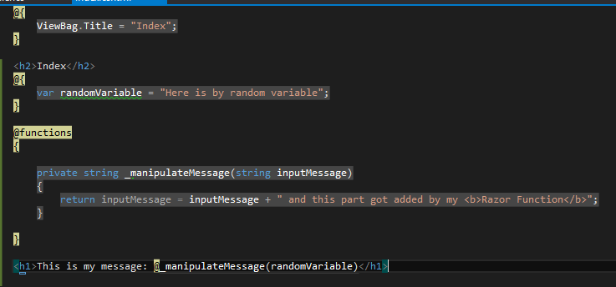
UI and Layouts

Slide 32
UI and Layouts
But my HTML was not rendered correctly
Enter HTML Helpers and Model Data
Razor is also an engine that renders HTML as shown next

Slide 33
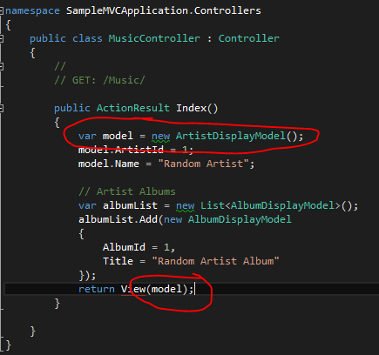
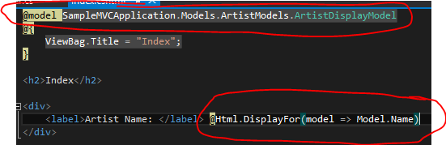

UI and Layouts
Shows
AND
More on Razor: http://www.asp.net/web-pages/overview/getting-started/introducing-razor-syntax-(c)

Slide 34
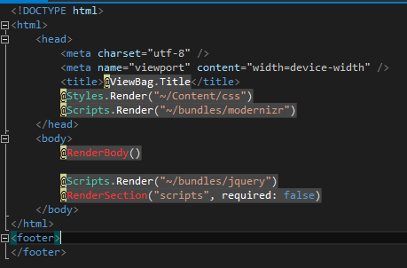
UI and Layouts
Now lets work on a layout that can be used across multiple views
A normal HTML document is split up between your:
Header – contains the rendering of scripts and styles.
Body – Contains the content for each page
Footer – General footer information
Your layout page contains these parts and the Razor for @RenderBody() is replaced with the body of the page that is injected

Slide 35
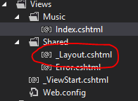
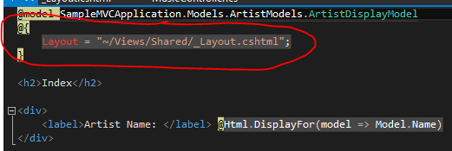
UI, Layouts and Themes
Reference the layout page
Layout page generated when project is created
Use Razor @ syntax to reference the layout page in your view

Slide 36
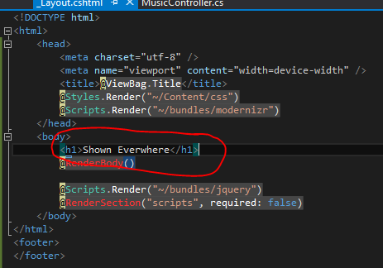
UI and Layouts
I added this here

Slide 37
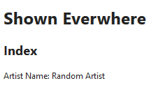
UI and Layouts
That text will be displayed everywhere
Now you can add styling that you want referenced on all pages
Lets add a navigation bar

Slide 38
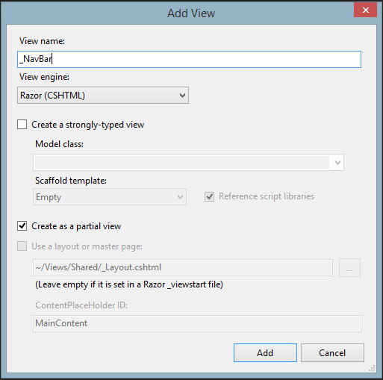
Working with Partials
Partial views do not contain any layout and can be used as standalone views that you can inject into other pages using the RenderPartial() method

Slide 39
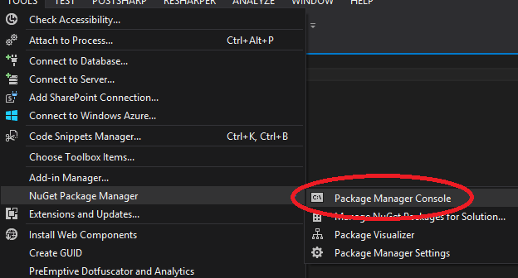
Working with Partials
But first, let’s add Twitter Bootstrap which makes UI layouts easier. Tools > NuGet Package Manager > Package Manager Console

Slide 40

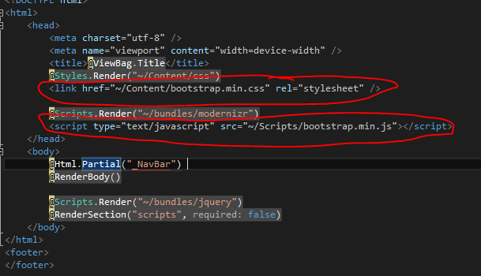
Working with Partials
https://www.nuget.org/packages/bootstrap/
In my layout page I add the following

Slide 41
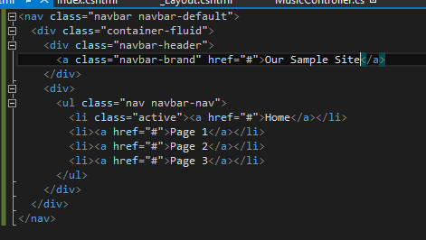

Working with Partials
In the _NavBar partial view I add the following
The CSS classes are those from bootstrap
The layout page also renders the _NavBar partial view

Slide 42

Working with Partials
Now all views that link the Layout will contain the new navbar

Slide 43


Working with Partials
You can render a partial directly from a view

Slide 44


Working with Partials
You can return the result of a partial view action result controller method using @Html.Action(“PartialViewResultName”,”ControllerName”)
You can also return the result of a partial view action result controller method using AJAX

Slide 45

Working with Partials

Slide 46
Javascript and Ajax
If you want to get data out, consider web API (covered later)
You can add script tags on views but rather combine related javascript functions into a script file and reference that script file in the view that requires it (a.k.a Page scripts)
Easier to read and cleaner

Slide 47


Working with data
In order to add a persistence layer, first you must have a database (not required when using a code first approach)
Data access in this context is simply a class library (DLL) that holds our ORM (Entity Framework)

Slide 48

Working with data
Next we reference that DLL in our MVC project
Change the database web.config to point to our database

Slide 49


Working with data
In your controller (for example) you can now reference the namespace of your data access layer to access the entities generated in Entity Framework and use them

Slide 50


Working with data
Dealing with forms
Example Login Form

Slide 51

Performance
Remember this
Notes:
<link href and the script tag loads in the stylesheet and javascript files into the header of the layout page

Slide 52
Performance
Since MVC 3, being able to bundle script files and css files was made available.
Bundling reduces the number of individual HTTP requests to server by combining multiple CSS files and Javascript files into single CSS file and javascript file.
Minification reduces the file download size of CSS and javascript files by removing whitespace, comments and other unnecessary characters.

Slide 53

Performance
As with Route Config (shown earlier), the Budle Config is stored in the App_Start folder

Slide 54

Performance
We can now move bootstrap into the bundle

Slide 55
Performance
There are two types of bundles mainly used:
Script Bundles – for javascript
Style Bundles – for css
“~/bundles/bootstrap” is the name of the bundle and it includes the javascript bootstrap file (already minified).
The same naming convention applies to the style bundle

Slide 56

Performance
Your layout page will now contain the bundles

Slide 57
Further Reading/Watching
ASP.NET Fundamentals Pluralsight Video
Using Bootstrap in ASP.NET MVC Pluralsight Video
Getting Started with Entity Framework 6 Code First using MVC
Deploy a Secure ASP.NET MVC 5 app with Membership, OAuth, and SQL Database to an Azure Website
SignalR
Security Extensibility in ASP.NET 4
ASP .NET MVC Basics – Videos – The guy’s voice is a little irritating and video 2 is pretty bad coming from Microsoft
Bundling and Minification

Slide 58
References
ASP.NET - http://www.asp.net/mvc/overview/getting-started/introduction/getting-started
^{[1]} Model – View – Controller - http://en.wikipedia.org/wiki/Model%E2%80%93view%E2%80%93controller
^{[2]} Introduction to ASP.NET MVC (Video 1) - Basics of MVC and Moving Parts - http://www.microsoftvirtualacademy.com/training-courses/introduction-to-asp-net-mvc
^{[3]} https://msdn.microsoft.com/en-us/library/cc668201.aspx

